Slide 1

COMP 5350 / 6350 / 6356 Digital Forensics Spring 2019

Slide 2
Project #1 Recommendations

Slide 3
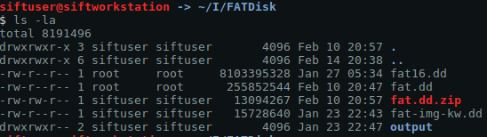
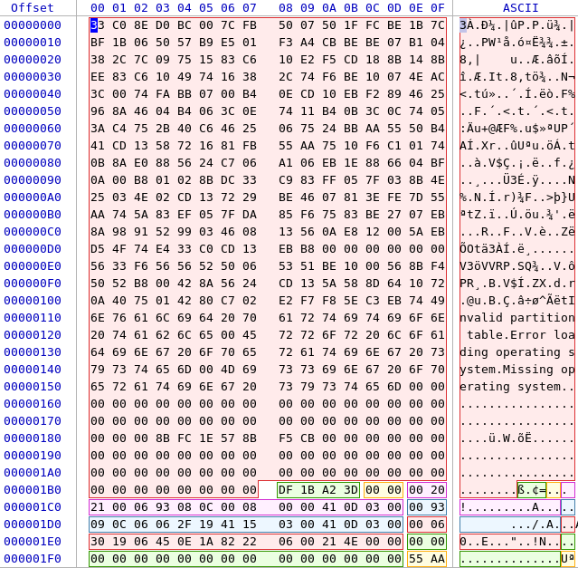
Partition Sector Start Locations
Partition #1: 0x800
Since these are the number
of sectors that we must move
to find the address we must
multiply by 512 bytes (0x200)
Partition #1
Boot Sector: 0x100000

Slide 4
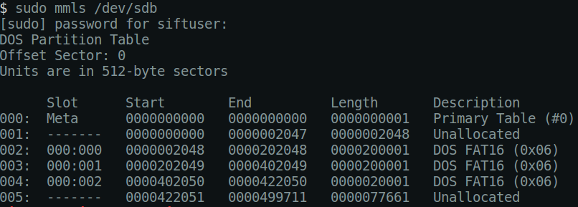
Partition Location Confirmation
Partition #1: 0x800 -> 2048

Slide 5
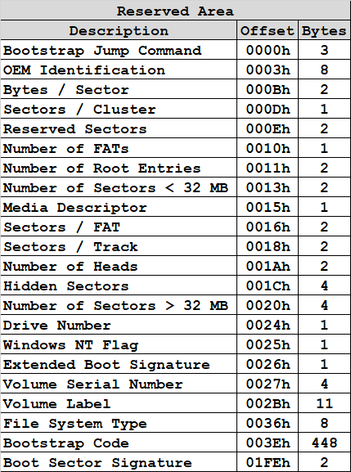
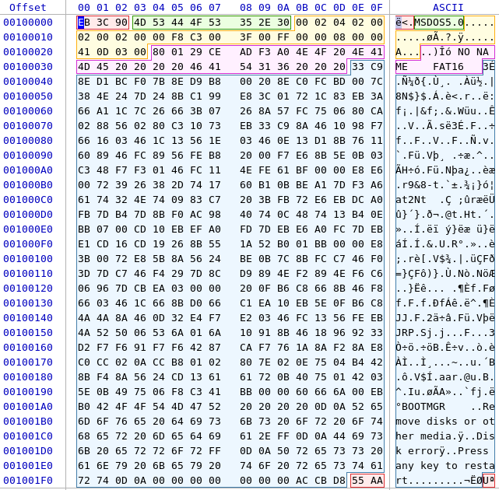
Partition #1 Boot Sector
Information gathered from the partition boot record for use later in the partition
??
??
??
??
??
??
??
??
??
?? bytes / sector
?? sectors / cluster
?? bytes / cluster

Slide 6
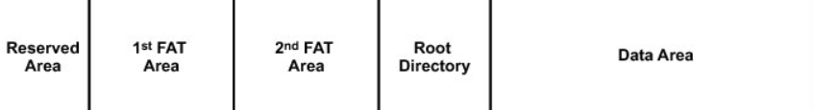
Partition #1 Areas
?
?
?
?
?
Sector ? - ?
Sector ? - ?
Sector ? - ?
Sector ? - ?
Sector ? - ?

Slide 7
Partition #1 Areas
Commands to display the contents of each area:
Reserved Area
Skip ? Sectors
? Sectors Long
sudo dd if=fat.dd skip=? count=? | hexdump -C
FAT #1
Skip ? Sectors
? Sectors Long
sudo dd if=fat.dd skip=? count=? | hexdump -C
FAT #2
Skip ? Sectors
? Sectors Long
sudo dd if=fat.dd skip=? count=? | hexdump -C
Root Directory
Skip ? Sectors
? Sectors Long
sudo dd if=fat.dd skip=? count=? | hexdump -C
Data Area
Skip ? Sectors
? Sectors Long
sudo dd if=fat.dd skip=? count=? | hexdump -C

Slide 8
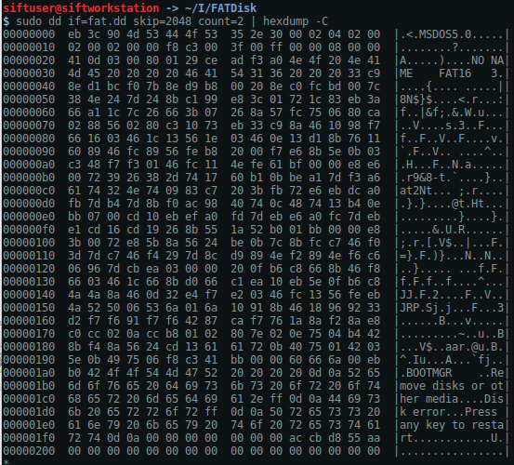
Boot Sector
sudo dd if=fat.dd skip=2048 count=2 | hexdump -C

Slide 9
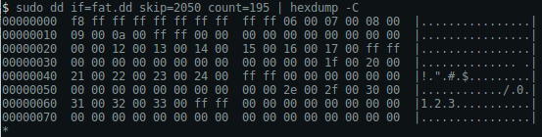
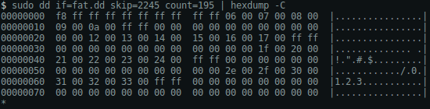
FAT #1 & FAT #2
sudo dd if=fat.dd skip=2050 count=195 | hexdump -C
sudo dd if=fat.dd skip=2245 count=195 | hexdump -C
Remember that after the first 4 bytes (i.e. 0xF8FF and 0xFFFF) the values represent either:
The Next Cluster (0x????)
End of File (0xFFFF)
No Content (0x0000)

Slide 10
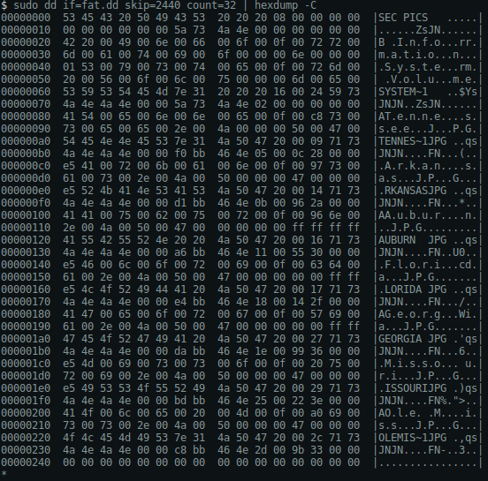
Root Directory Structure
sudo dd if=fat.dd skip=2440 count=32 | hexdump -C

Slide 11
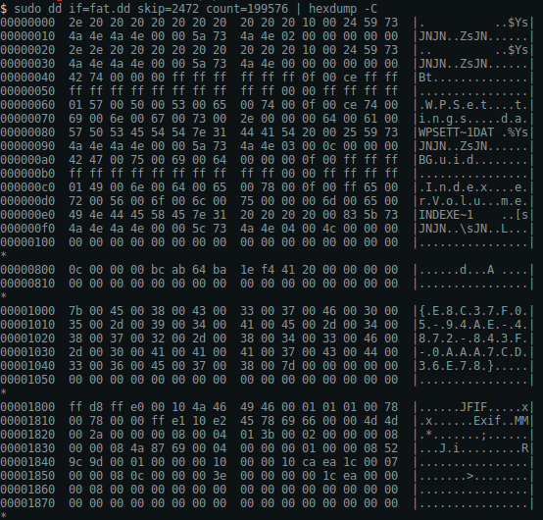
Data Area
sudo dd if=fat.dd skip=2472 count=? | hexdump -C

Slide 12
Root Directory - Filename, Cluster, & Size
Filename | Cluster | Size
Tennesseee.jpg | 0x0005 | 10,252

Slide 13
Where does file data start?
2 + 195 + 195 + 32 + 12 = 436
12
The start of user
file contents is
at sector X
2
195
195
32
?
Filename | Cluster (Hex) | Cluster (Dec) | Start Sector (Partition) | Start Sector (Disk) | Storage Address (Hex) | Bytes (Disk) | Size (Bytes)
Tennessee.jpg | 0x0005 | 5 | 436 | 2484 | 0x136800 | 1,271,808 | 10,252
? | ? | ? | ? | ? | ? | ? | ?
? | ? | ? | ? | ? | ? | ? | ?
? | ? | ? | ? | ? | ? | ? | ?
? | ? | ? | ? | ? | ? | ? | ?
Filename(Active / Deleted)
sudo dd if=fat.dd of=Tennessee.jpg bs=1 skip=1271808 count=10252

Slide 14
File Allocation Table
Allocated
Unallocated
Data Area Cluster | Next Cluster
0x0000 | 0xF8FF
0x0001 | 0xFFFF
0x0002 | 0xFFFF
0x0003 | 0xFFFF
0x0004 | 0xFFFF
0x0005 | 0x0006
0x0006 | 0x0007
0x0007 | 0x0008
0x0008 | 0x0009
0x0009 | 0x000A
0x000A | 0xFFFF
0x000B | 0x????
0x000C | 0x????
0x000D | 0x????
0x000E | 0x????
0x000F | 0x????
Data Area Cluster | Next Cluster
0x0010 | 0x????
0x0011 | 0x????
0x0012 | 0x????
0x0013 | 0x????
0x0014 | 0x????
0x0015 | 0x????
0x0016 | 0x????
0x0017 | 0x????
0x0018 | 0x????
0x0019 | 0x????
0x001A | 0x????
0x001B | 0x????
0x001C | 0x????
0x001D | 0x????
0x001E | 0x????
0x001F | 0x????
Data Area Cluster | Next Cluster
0x0020 | 0x????
0x0021 | 0x????
0x0022 | 0x????
0x0023 | 0x????
0x0024 | 0x????
0x0025 | 0x????
0x0026 | 0x????
0x0027 | 0x????
0x0028 | 0x????
0x0029 | 0x????
0x002A | 0x????
0x002B | 0x????
0x002C | 0x????
0x002D | 0x????
0x002E | 0x????
0x002F | 0x????
Data Area Sector | Next Sector
0x0030 | 0x????
0x0031 | 0x????
0x0032 | 0x????
0x0033 | 0x????
0x0034 | 0x????
0x0035 | 0x????
0x0036 | 0x????
0x0037 | 0x????
0x0038 | 0x????
0x0039 | 0x????
0x003A | 0x????
0x003B | 0x????
0x003C | 0x????
0x003D | 0x????
0x003E | 0x????
0x003F | 0x????

Slide 15
Memory Dump Formats and Utilities

Slide 16
Live Memory Dump Formats
Live memory capture involves collecting system RAM to identify key system and user activities including
Running Services and Processes
Operating System Configuration
Deleted and Temporary Data
Volatile Data
Just as with storage formats there are numerous types of live memory dumps to be familiar with
Memory dump formats can occur do to the structure of the RAM and virtual memory being collected
A list of live memory dumps include:
Raw Memory Dump
Windows Crash Dump
Windows Hibernation Files
Expert Witness Format
HPAK Format

Slide 17
Raw Memory Dump
Just as with raw images for storage devices, raw memory can also be collected in a raw format
Structures between storage and memory devices is different
Raw memory does not contain any header, metadata, or file signature identification
All analysis tools take in raw memory dumps, but must first convert them into a usable format for analysis

Slide 18
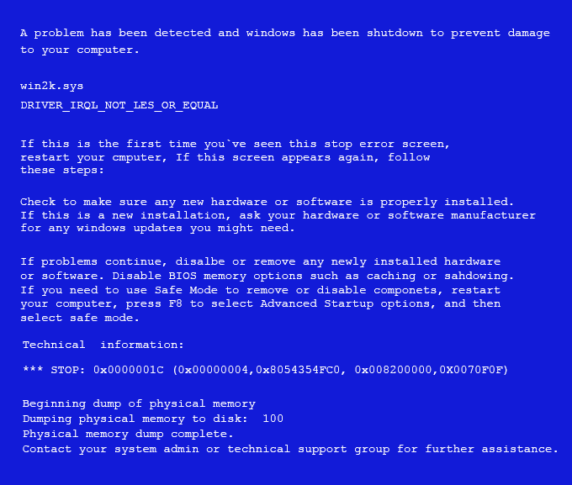
Windows Crash Dump
When Windows experiences a set of conditions that results in a system crash, a crash dump file is generated
Volatility can take the crash dump file format and identify certain issues relative to the system, but this method is not the best from a forensic standpoint
Crash dumps can be created on Windows systems through the use of:
Blue Screens
SysInternals - NotMyFault
CrashOnScrollControl
PS/2 & USB Keyboards
Debuggers
Remote Kernel Debugger .crash and .dump commands

Slide 19
Windows Hibernation Files
Windows OS’s produce a compressed copy of memory that is dumped to disk when executing the hibernation process
hiberfil.sys
Forensic analysis of hibernation files started in 2008
Sandman
Due to the compressed nature of hibernation files, analysis requires decompressing
Hibernation files can not substitute for live memory captures since networking and connection data are lost during the hibernation process

Slide 20
EnCase Expert Witness Format
EnCase Expert Witness format is used for memory dumps
EWF format - EnCase Version <= 6
EWF2-EX01 Format - EnCase Version 7
There are three different methods of analyzing EWF memory dumps with Volatility
EWFAddresSpace
Volatility can be configured with a EWF module called libwef
Currently works with EWF format only
Mounting with EnCase
Mounting EWF file with EnCase and run Volatility over the device
Mounting with FTK Imager
Mounting EWF as a physical and logical device with FTK Imager and run Volatility on the image

Slide 21
HPAK Format
HPAK format combines both physical memory and Windows page files into the same output
HPAK is a proprietary format used by the FastDump utility
If using FastDump, the HPAK format must be specified with the –hpak option, otherwise it will generate a raw memory dump
When analyzing HPAK formatted memory dumps with volatility, the *.hpak file extension will be utilized

Slide 22
Virtual Machine Memory Dumps
It is important to understand the difference between host-based live memory versus virtual machine live memory
The host provides VM’s with their resources so there are some similarities to what is collected
We have been introduced to the different hypervisor configurations
Type I Hypervisor
Type II Hypervisor
There are numerous methods of collecting live memory from a virtual machine
Direct VM Memory Acquisition
Hypervisor Memory Acquisition
Hypervisor Forensics
Hypervisor memory acquisition is less invasive

Slide 23
Virtual Machine Hypervisor Memory
There are a number of well-known hypervisors and each of them has different considerations when considering forensic memory collection
VMWare
Suspending, pausing, or snapshotting the VM results in a copy of memory on the hosts file system and is tracked in the .vmx configuration file
VirtualBox
Does not create a memory when suspending, pausing, or snapshotting
Three method of creating a VB memory dump
vboxmanage debugvm
Debug when starting a VM session and use .pgmphystofile command
Utilize VirtualBox Python API; vboxapi
A tool called Cuckoo Sandbox can be used to save VB memory dumps from VB VMs to ELF64 core dump format
QEMU
Very similar configuration to VB and saves VM memory in ELF64 core dump format
Xen / KVM
Utilizes the LibVMI library which can collect real-time memory extraction without the need for running code inside the VM
Microsoft Hyper-V
To save live memory, it is necessary to save the VM state or create a snapshot
Locate .bin, physical memory file, and .vsv, metadata from the configuration directory
Volatility does not support Hyper-V directly and requires the vm2dmp tool to concert the files to a Windows crash dump

Slide 24
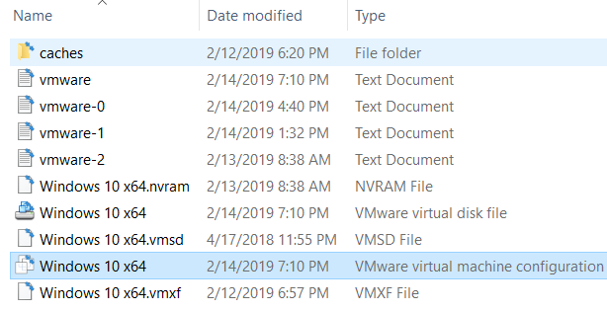
VMWare Memory Related Files
VMWare related to memory files
.vmx
VM Configuration File
.vmem
VM Memory
.vmsn
VM Snapshot
.vmss
VM Saved Data
.nvram
VM BIOS

Slide 25
Type I Hypervisor
Host Memory Acquisition
Host memory acquisition collects the entire host physical memory and host pagefiles
VM #1
VM #2
VM #3
1
CPU
20
GB
500
GB
1
NIC
2
CPU
5
GB
1
TB
1
NIC
2
CPU
10
GB
2
TB
1
NIC
Hypervisor
8 CPUs
64 GB
10 TB
6 NICs
Host Hardware

Slide 26
Type I Hypervisor
VM Memory Acquisition
VM memory acquisition collects VM physical memory (i.e. part of the host physical memory) and VM pagefiles
VM #1
VM #2
VM #3
1
CPU
20
GB
500
GB
1
NIC
2
CPU
5
GB
1
TB
1
NIC
2
CPU
10
GB
2
TB
1
NIC
Hypervisor
8 CPUs
64 GB
10 TB
6 NICs
Host Hardware

Slide 27
Type II Hypervisor
Host Memory Acquisition
Host memory acquisition collects the entire host physical memory and host pagefiles
VM #1
VM #2
VM #3
1
CPU
20
GB
500
GB
1
NIC
2
CPU
5
GB
1
TB
1
NIC
2
CPU
10
GB
2
TB
1
NIC
Hypervisor
Host Operating System
8 CPUs
64 GB
10 TB
6 NICs
Host Hardware

Slide 28
Type II Hypervisor
VM Memory Acquisition
VM #1
VM #2
VM #3
1
CPU
20
GB
500
GB
1
NIC
2
CPU
5
GB
1
TB
1
NIC
2
CPU
10
GB
2
TB
1
NIC
Hypervisor
Host Operating System
8 CPUs
64 GB
10 TB
6 NICs
Host Hardware

Slide 29
Hypervisor Forensics
Instead of attempting to collect memory dumps from inside of a VM, research has shown that hypervisors can be analyzed directly from the host memory
An open source tool called Actaeon, can take a host memory and perform memory forensics of virtualization environments
With a host memory dump, Actaeon can achieve three objectives:
Locate any hypervisor configured with Intel VT-x technology
Show relationships among different hypervisors running on a host
Recognize address space of each VM
Actaeon consists of three components:
hyperls
Volatility plugin to list the hypervisors in a memory dump
Volatility patch to allow plugins and commands to be applied to each guest OS
A Virtual Machine Control Structure (VMCS) layout dumper

Slide 30
Windows Volatile Memory Collection

Slide 31
Memory Acquisition Tools
Main memory accesses data randomly instead of sequentially like it is on block devices allowing quicker data access
List of known Windows memory acquisition tools:
FTK Imager - AccessData
DumpIt - MoonSols
Rekall - Open Source
KnTTools - GMG Systems
F-Response – F-Response
Memoryze - Mandiant
FastDump – HBGary
WinEn - EnCase
Live RAM Capturer - Belkasoft
Windows Memory Reader - ATC-NY
The need for multiple memory acquisition tools serves multiple purposes
Different OS’s work better with some tools
Different acquisition tools may find different valuable digital artifacts

Slide 32
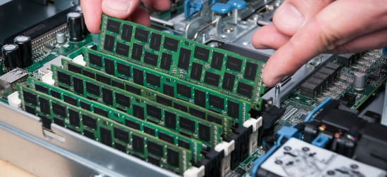
Live Memory Acquisition Considerations
Before determining which tools and techniques are needed for live memory acquisition, it is necessary to answer some preliminary questions
Local vs. Remote
Virtual Machine vs. Physical Host
Workstation vs. Server
Administrative Access vs. User Access
Large vs. Small Memory Collection
CLI vs. GUI

Slide 33
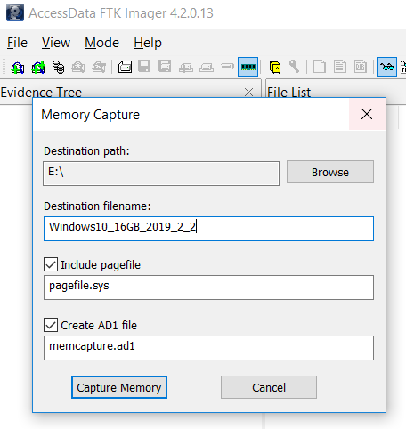
FTK Imager
In addition to disk images, FTK Imager also has the ability to collect live memory dumps
Each memory dump is saved as a *.mem file and can then be fed into a memory analysis toolkit
Best practices recommend running FTK Imager from removable media and storing the results of memory analysis on external systems
In addition to main memory, it is also possible to extract the Windows pagefile which can provide additional insight into live system

Slide 34
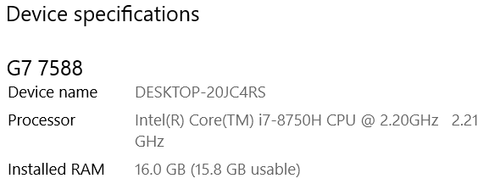
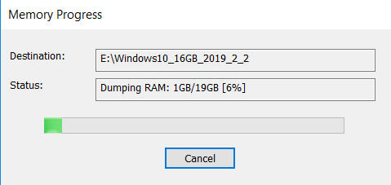
FTK Imager – RAM Extraction
Why is there an difference
between system and extractor tool RAM size?

Slide 35
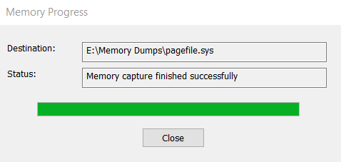
Windows Pagefile
The Windows pagefile is used to aid in the management of system RAM
The operating system determines the most and least used pages in RAM
For the least used pages, they are moved from RAM into a file named pagefile.sys on disk
Once those least used pages are moved, RAM is now freed up for immediate use
In addition to imaging physical RAM, it is also possible to copy the pagefile for forensic analysis

Slide 36
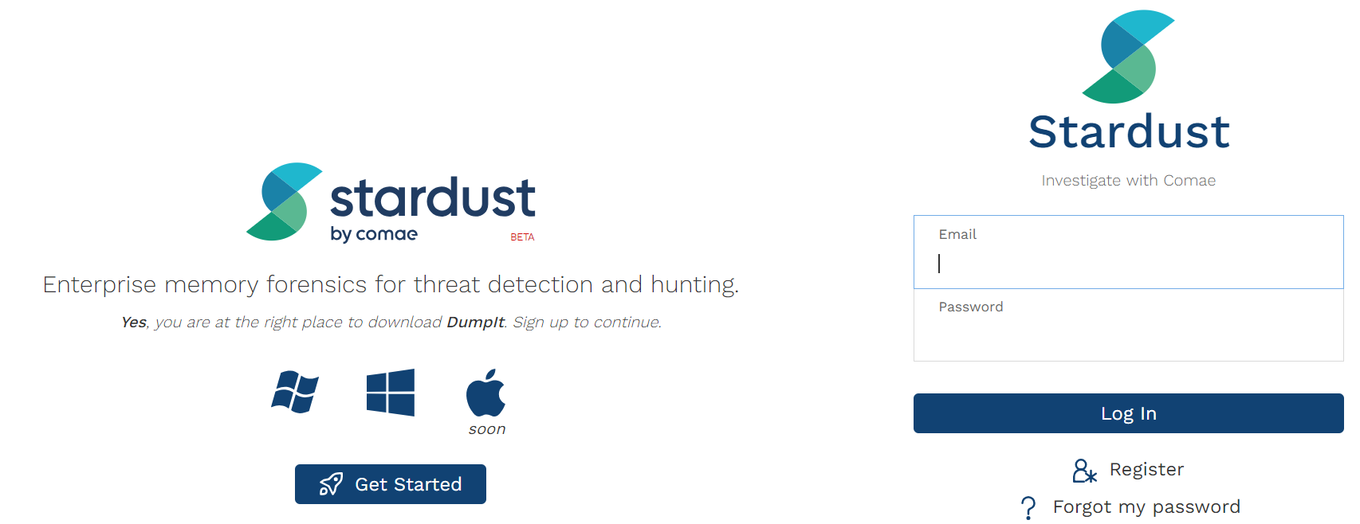
DumpIt
Freely available memory acquisition software originally called win32dd
Allows physical memory acquisition on Windows as a raw memory dump or as a Microsoft crash dump
DumpIt creates both .mem and .raw files during acqusition

Slide 37
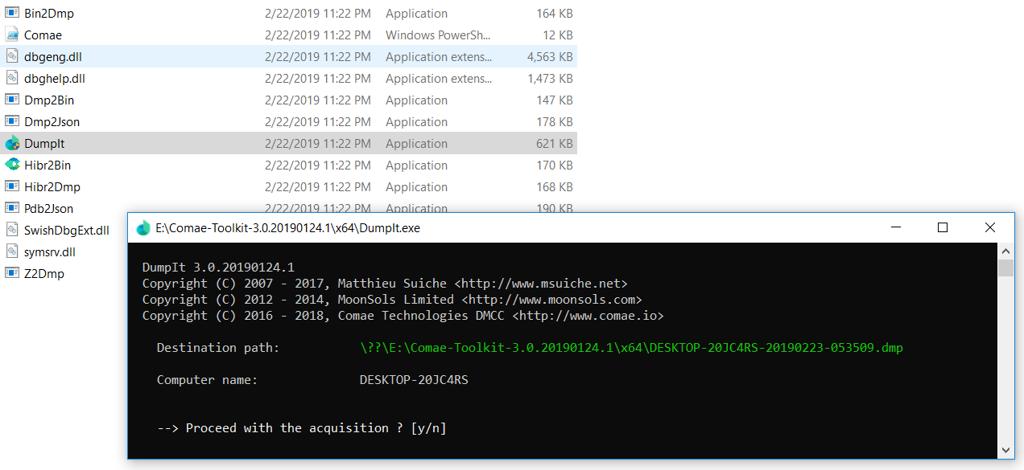
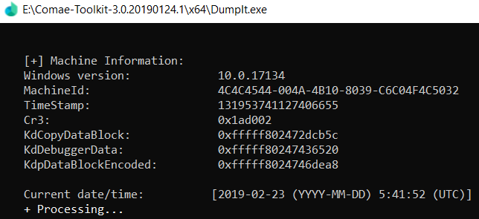
DumpIt Acquisition
DumpIt can be utilized in either CLI or GUI mode
DumpIt application saves each dump as a *.dmp file

Slide 38
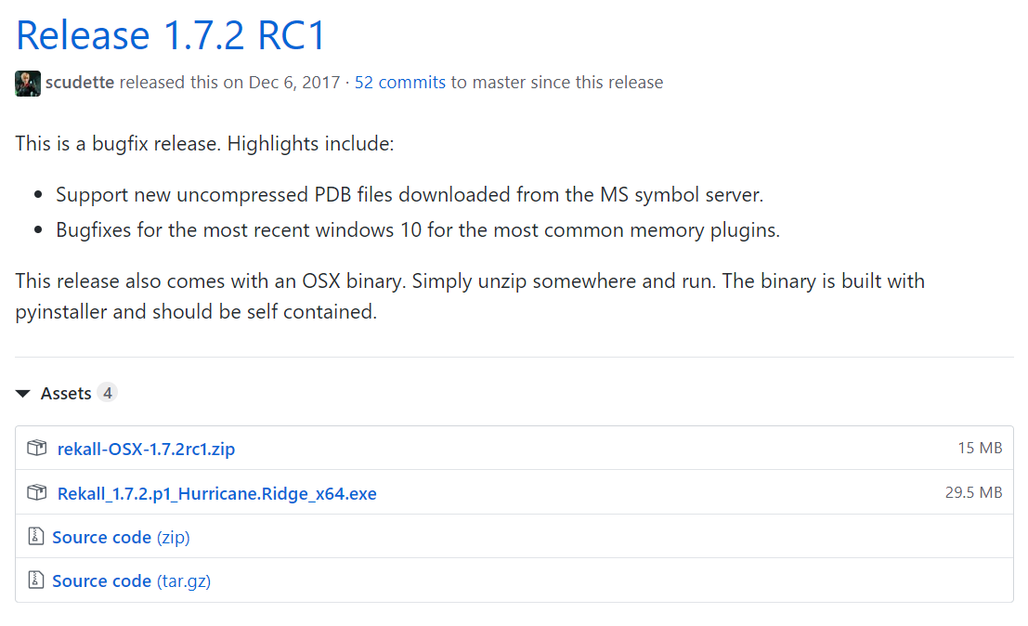
Rekall
Open source memory acquisition software
https://github.com/google/rekall/releases
Allows physical memory acquisition on Windows as a raw memory dump or as a Microsoft crash dump

Slide 39
Windows Volatile Memory Analysis

Slide 40
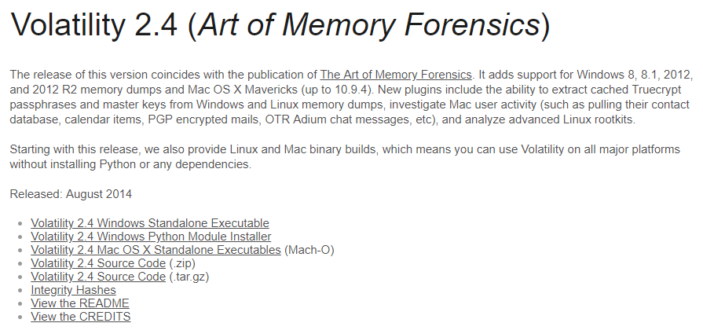
Volatility Framework
Integrated into SANS SIFT
Address Space Voting Rounds
Explicit file format search
Cross Platform
https://www.volatilityfoundation.org/24

Slide 41
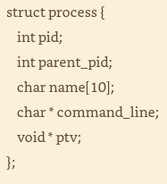
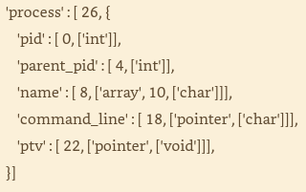
Volatility Framework Developer Considerations
VTypes
Most OS’s are written in C
Volatility is written in Python
VTypes is a way to represent C data structures in Python source files
The structures can contain object names, offsets, and types that match the operating system being analyzed
By translating these structures Volatility knows how to treat the underlying data as either an integer, string, or pointer
Structure Name
Structure Size
Process ID
Offsets
Parent PID
PID Name
Pointer
Pointer
Structure
VType

Slide 42

Volatility Overlays
C-based operating systems, such as Windows, utilize numerous void pointers (void *) throughout the codebase
A void pointer is a pointer to data whose type is unknown or arbitrary at the time of the allocation
There is usually not enough information based on the void pointer to derive the data types automatically and additional steps, such as dereferencing pointers may be necessary
Overlays allow us to essentially patch the generated structure definitions
The process to create an overlay is usually though reverse engineering or trial and error
No Change
Overlay
Structure
VType

Slide 43
Volatility Object & Classes
A Volatility object is an instance of a structure that exists at a specific address within an address space (AS) which is an interface into a memory dump file
Example: Instantiate an _EPROCESS structure at address 0x80dc1a70 of your memory dump
An object is usually created through a call to Volatility’s obj.Object() API
Through the API, we can access each of the underlying structure members
To extend the functionality of an object we can use an object class which allows us to attach methods or properties to an object that then become accessible to all instances of the object
Object classes allow code sharing between plugins and enables API use in the framework
Example: Lets assume that a significant number of plugins use _EPROCESS objects and they all need to identify suspicious processes
An object class can be written to filter for suspicious processes

Slide 44
Volatility Profiles
A profile is a collection of the VTypes, overlays, and object classes for a specific operating system version and hardware architecture
x86
x64
ARM
Profiles also include:
Metadata
OS Name
Kernel Version
Build Number
System Call Information
System Call Indexes and Names
Constant Values
Global Variables With Hard-Coded Addresses
Native types
Low-level language types (int, char, long)
System map
Critical Global Variables and Functions Addresses
Each profile has a unique name based on OS's name, version, service pack, and architecture
Win7SP1x64 - 64-bit Windows 7 Service Pack 1 System
Win2012SP0x64 - 64-bit Windows Server 2012

Slide 45
Volatility Address Spaces
Address spaces (AS) provide access to data in RAM, handle virtual-to-physical-address translation, and accounts for differences in memory dump file formats
AS's are configured to recognize memory layouts and storage methods to recreate memory

Slide 46
Volatility Virtual / Paged Address Spaces
Virtual / Paged Address Spaces are used to reconstruct virtual memory
VPASs use Intel and AMD-based algorithms to translate physical to virtual memory
An important aspect regarding virtual ASs is that they deal only with memory that is both allocated and accessible and does not include swapped disk
A virtual AS contains the subset of memory that programs on a system can “see” at the time of the acquisition without producing a page fault to read swapped data back into RAM
VPASs are composed of kernel and process ASs
Kernel AS provides a view of the memory that is allocated and accessible to device drivers and modules running in kernel mode
A process AS provides a view of memory from the perspective of a specific process which each have a private AS
Mapping back data found in a memory dump to the processes that were currently accessing it is a common investigative technique

Slide 47
Volatility Physical Space
Physical AS have to do with various file formats that memory acquisition tools use to store physical memory
Physical AS also include crash dumps, hibernation files, and VM snapshots
Unlike virtual AS, physical AS contain memory ranges that the OS has marked as freed or de-allocated allowing historical artifact analysis

Slide 48
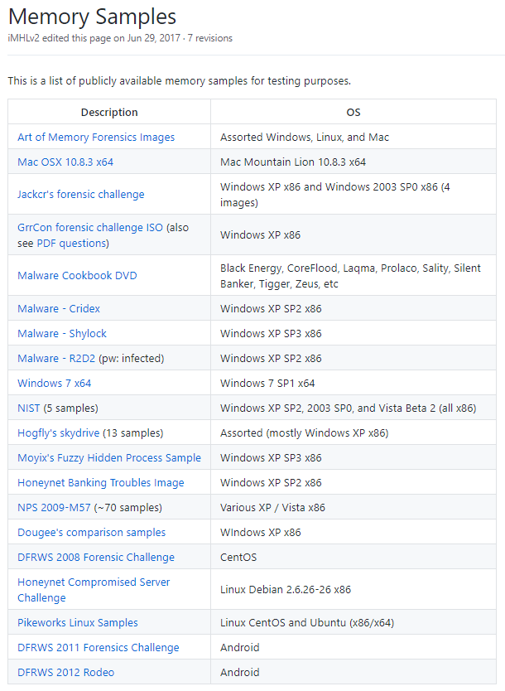
Example Memory Dumps
There are numerous repositories for example memory dump files
We will make use of the Volatility Foundation repository
https://github.com/volatilityfoundation/volatility/wiki/Memory-Samples

Slide 49
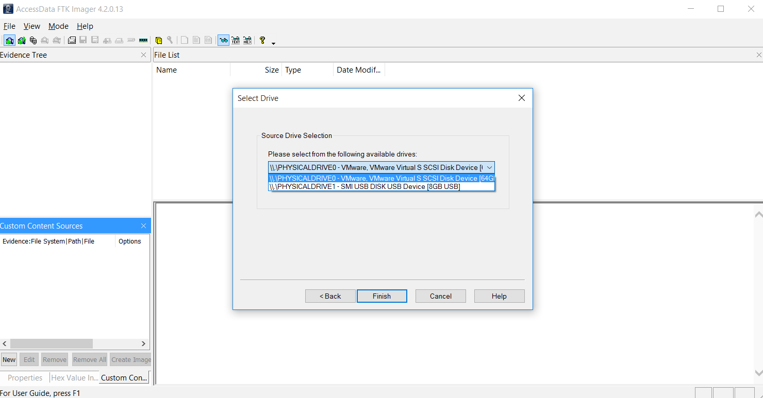
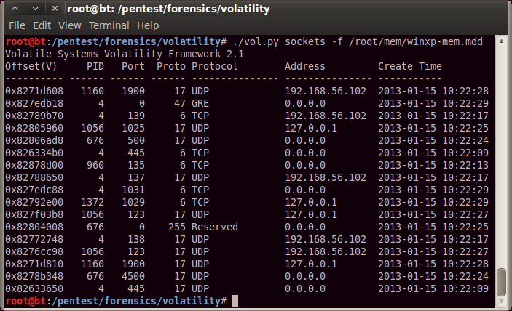
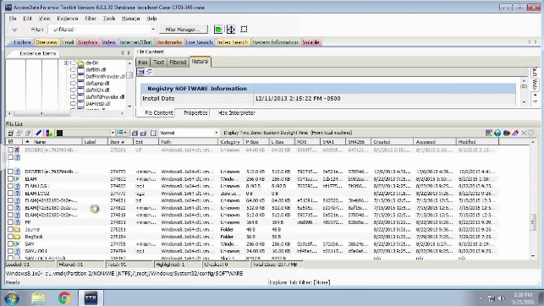


Collect Volatile Evidence – Removable Media
Toolkit
Target System
Analysis System

Slide 50
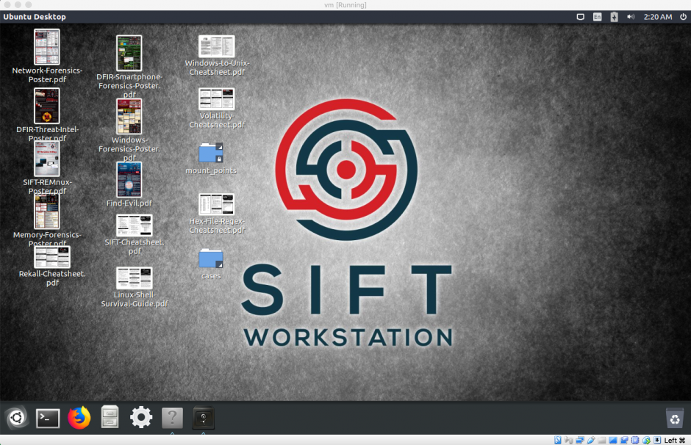
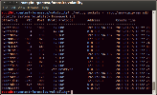

Analyze Volatile Evidence – Removable Media
Toolkit
Target System
Analysis System

Slide 51
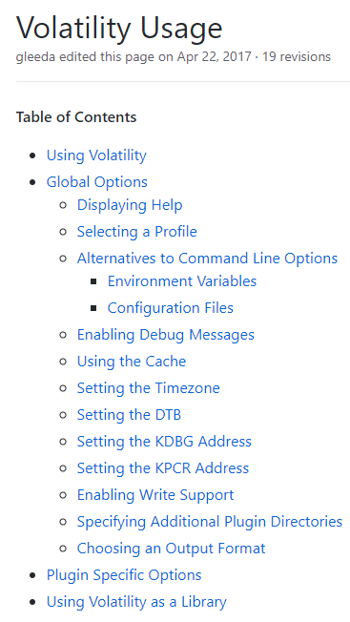
Live Memory Analysis
With a full copy of the Windows memory available for analysis, we will now utilize volatility to identify key information
Analysis Process:
Mount analysis drive
Identify Volatility Usage &

Slide 52
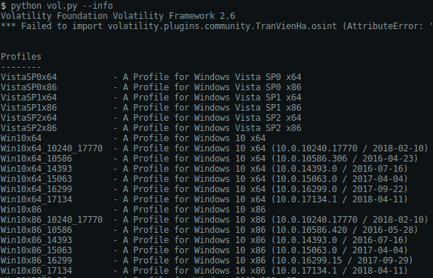
Volatility Commands - Profiles
Utilize Volatility info to find a listing of all available profiles
python vol.py --info
Use the profile to build the Volatility commands

Slide 53
Volatility imageinfo
Volatility's imageinfo output specifies the suggested profile (--profile=PROFILE) for use with other plugins
imageinfo prints the "_KDDEBUGGER_DATA64" (KDBG) structure used by plugins like pslist and process finding modules
For larger memory samples there may be multiple KDBG structures
The Volatility imageinfo plugin will not work on hibernation files unless the correct profile is given in advance because important structure definitions vary between different OS's

Slide 54
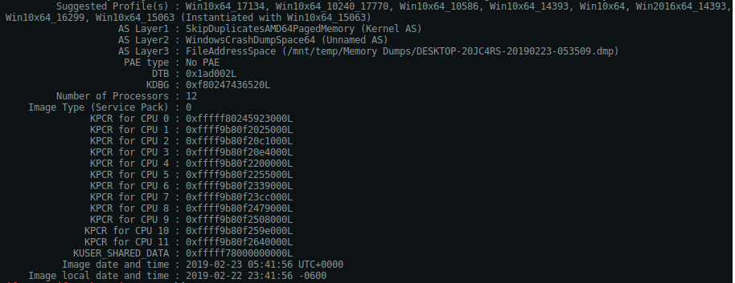
Volatility Commands – Image Identification
Utilize Volatility imageinfo to find image information
python vol.py –f <IMAGE_LOCATION> imageinfo
--profile=Win10x64_17134

Slide 55
Volatility kdbgscan
Volatility's kdbgscan is designed to positively identify the correct profile and KDBG structure addresses
KDBG Structure
Maintained by the Windows kernel for debugging purposes
Contains a list of the running processes, loaded kernel modules, and version information
This structure is important because it can identify memory dumps from different Windows OS’s

Slide 56
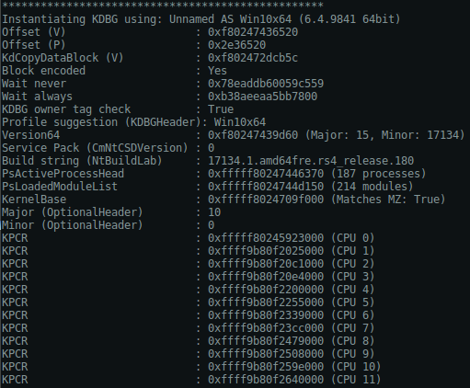
Volatility Commands – Positive Profile Detection
Utilize Volatility imageinfo to find image information
python vol.py –f <IMAGE_LOCATION> kdbgscan

Slide 57
Volatility pslist
pslist lists system processed and shows the offset, process name, process ID, the parent process ID, number of threads, number of handles, and date/time when the process started and exited
pslist does not detect hidden or unlinked processes
Note: Two Windows processes that do not have Session ID's include System and smss.exe since they starts before sessions are established and smss.exe is the session manager itself

Slide 58
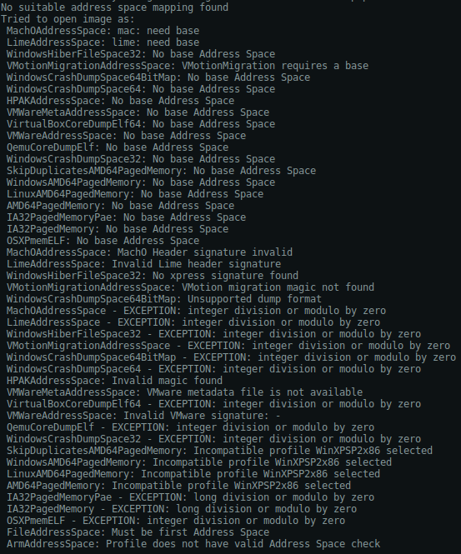
Volatility Commands – Processes pslist
Utilize Volatility process commands identify
python vol.py –f <IMAGE_LOCATION> pslist

Slide 59
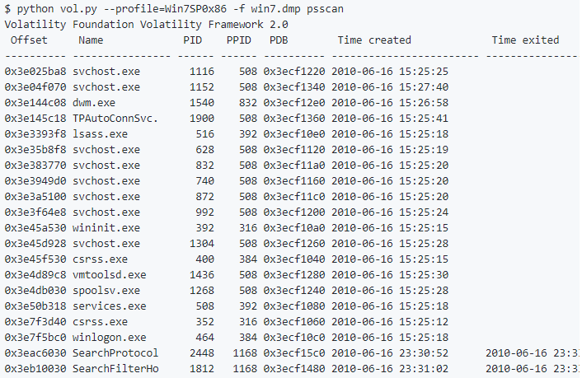
Volatility Commands – Processes psscan
Utilize Volatility process commands identify
python vol.py –f <IMAGE_LOCATION> psscan

Slide 60
Windows Core Processes
In order to do forensic analysis on Windows processes, it is important to be able to identify the Windows core processes:
System
The System process manages system memory and compressed memory in the NT kernel
The system process is a single thread running on each processor
smss.exe
A component of the Microsoft Windows NT that
Creates environment variables
Starts kernel and user modes
Creates DOS device mappings
Creates virtual memory paging files
Starts the Windows logon manager, winlogon.exe
wininit.exe
Responsible for the Windows initialization process
taskhost.exe
Acts as a host for processes that run from dynamic link libraries (dll) instead of exe
Checks the Windows registry on startup to discover dll-based services that need to be loaded
lsass.exe
Local Security Authentication Server
Verifies user logons on a system

Slide 61
Windows Core Process Details
Process Name | Parent Process | File Path | Singleton | Account | Start Time
SYSTEM | None | None | Yes | Local System | Boot
smss.exe | SYSTEM | System32smss.exe | No | Local System | Boot
wininit.exe | None | System32winint.exe | Yes | Local System | Boot
taskhost.exe | services.exe | System32taskhost.exe | No | Many | Varies
lsass.exe | wininit.exe | System32lsass.exe | Yes | Local System | Boot
winlogon.exe | None | System32winlogon.exe | No | Local System | Varies
iexplore.exe | explorer.exe | \Program Files \InternetExplorer\iexplorer | No | Local Users | Varies
explorer.exe | userinit.exe | SystemRoot% \explorer.exe | No | Local Users | Varies
lsm.exe | wininit.exe | \System32\lsm.exe | Yes | Local System | Boot
svchost.exe | services.exe | \System32\svchost.exe | No | Local System Network Service Local Service | Boot
services.exe | wininit.exe | \System32\services.exe | Yes | Local System | Boot
csrss.exe | None | \System32\csrss.exe | No | Local System | Boot

Slide 62
Windows Core Process Details
There are a number of techniques that can be used to manipulate and hijack processes within the Windows OS
Process Name Change
Changing Parent Processes
Manipulate File Path
Running Multiple Instances
Changing Accounts
Start Time Discrepancy

Slide 63
Volatility Command Reference
Volatility provides a command reference with major topic areas of:
Image Identification
Processes and DLLs
Process Memory
Kernel Memory
Networking
Registry
Crash Dumps & Hibernation
File System
Examples and content can be found in the Github repository:
https://github.com/volatilityfoundation/volatility/wiki/Command-Reference

Slide 64
Mid-Term Information
2 parts
1st Part – Canvas
35%
Open Notes
Open Internet
2nd Part – In Class / With Proctor
65%
Materials Provided

Slide 65
References
The Art of Memory Forensics, 2014
Windows Registry Forensics, Carvey, 2009
Volatility Framework
https://www.volatilityfoundation.org/24
Rekall Forensic Acquisition Tool
https://github.com/google/rekall/releases
Actaeon Hypervisor Forensic Tool
http://s3.eurecom.fr/tools/actaeon/

